Slide 1
*args and **kwargs in Python
DVT101 – Lecture 14
- By Dataverse Tutorials

Slide 2
Why Do We Need *args and **kwargs?
Functions with fixed parameters have limitations
Real programs need flexible input handling
*args and **kwargs solve this problem
Makes functions reusable and scalable
Widely used in Python libraries & frameworks

Slide 3
Understanding Variable Length Arguments
*args → Positional arguments
**kwargs → Keyword arguments
args are stored as tuple
kwargs are stored as dictionary
Naming is flexible (*values, **details etc.)

Slide 4
How Python Internally Handles *args & **kwargs
Function call ke time packing hoti hai
*args → tuple packing
**kwargs → dictionary packing
Order matters (*args always before **kwargs)
Interpreter automatic conversion karta hai

Slide 5
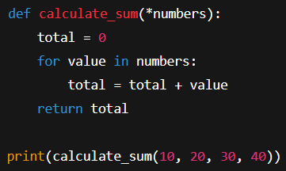
Using *args to Accept Multiple Values
Accept unlimited positional values
Stored as tuple
Looping possible
Useful for calculations

Slide 6
Where *args is Used in Industry
Logging systems
Mathematical operations
Data preprocessing
Feature engineering pipelines

Slide 7
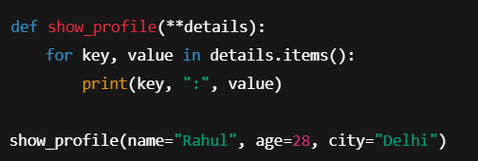
Understanding **kwargs
Accept key=value pairs
Stored as dictionary
Keys are strings
Useful for named data

Slide 8
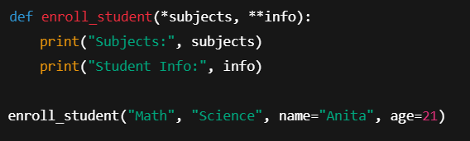
Using *args and **kwargs Together
Maximum flexibility
Common in frameworks
Positional + Named inputs
Clean API design

Slide 9
Best Practices for *args and **kwargs
Avoid overusing
Keep function readable
Always document parameters
Maintain order

Slide 10
Key Learnings from This Lecture
*args → tuple of positional arguments
**kwargs → dictionary of keyword arguments
Makes code flexible
Widely used in industry
Must-know for interviews

Slide 11


